Slide 1
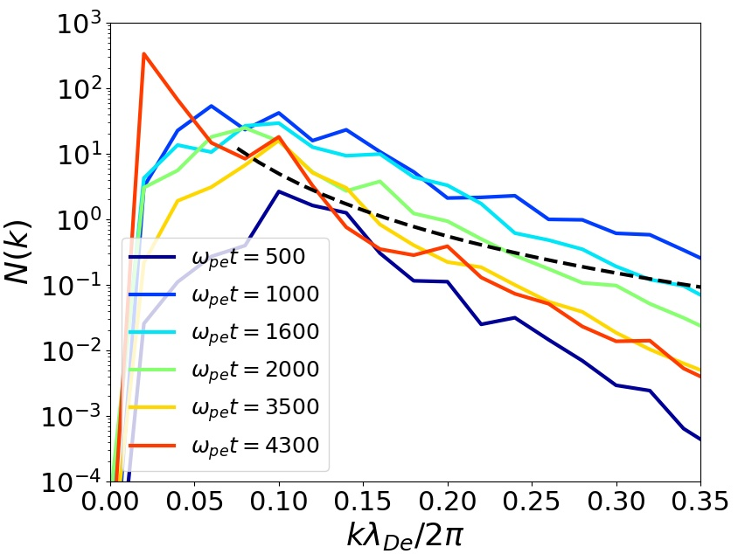
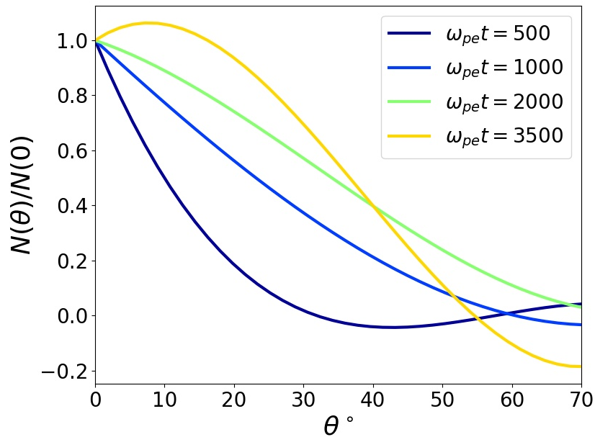

(a)
(b)
$$∝\frac{1}{k^{3}}\ln{\frac{1}{kλ_{De}}}$$

